Slide 1

Session 6
Preserving the Past
Jody Beenk

Slide 2
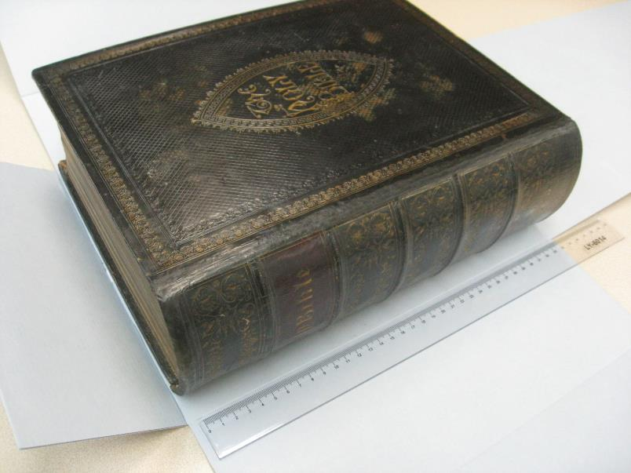
The 16th Annual Library Leadership Institute
Beyond the bubble: Libraries leading and collaborating across boundaries
Preserving the Past
PRESERVATION & CONSERVATION
University of Hong Kong Libraries
JODY BEENK, APRIL 2018

Slide 3
OUTLINE
Preservation in general
Preservation at HKU Libraries
How we strive to lead and collaborate through preservation outreach
WORKSHOPS • LECTURES • EXHIBITIONS • ACTIVITIES
Participant activity

Slide 4
The 16th Annual Library Leadership Institute
Beyond the bubble: Libraries leading and collaborating across boundaries

Slide 5
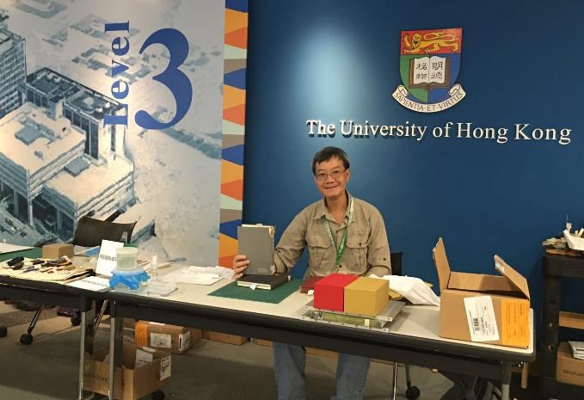
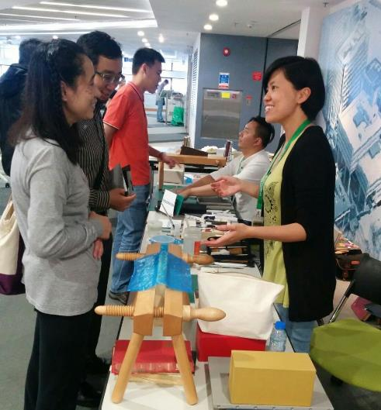
Preservation Week 2016 – book repair demonstrations and exhibit

Slide 6
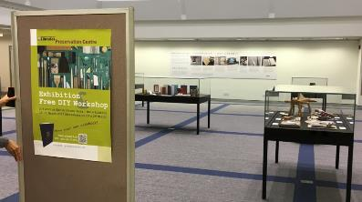
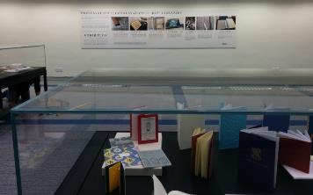
Preservation Week 2017 - EXHIBITION

Slide 7
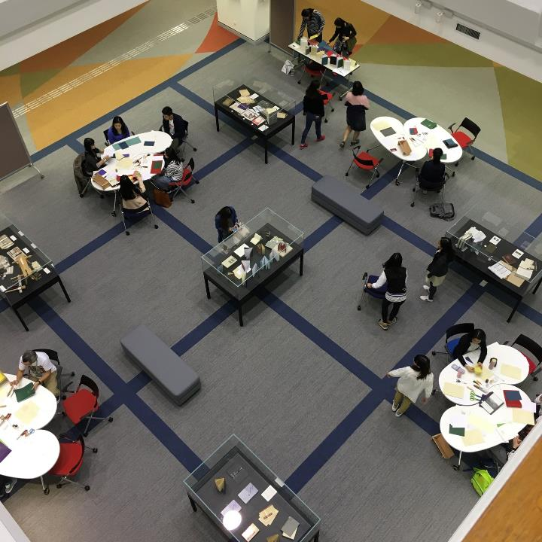
Preservation Week 2017
DIY NOTEBOOK MAKING
WORKSHOPS
(and exhibition)

Slide 8
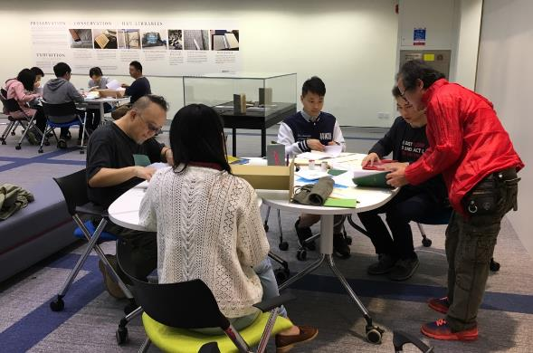
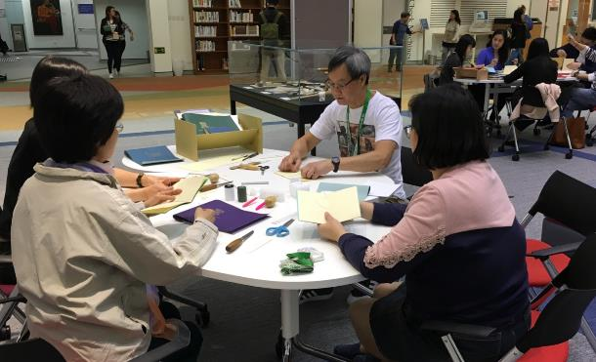
Preservation Week 2017
DIY NOTEBOOK MAKING

Slide 9
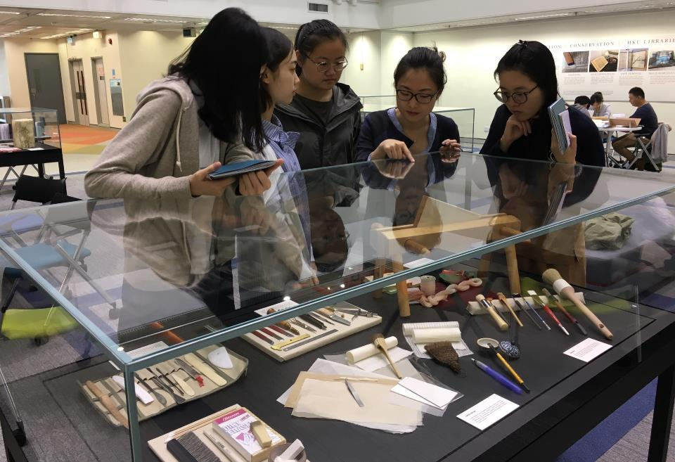
Preservation Week 2017
DIY NOTEBOOK MAKING
WORKSHOPS
(and exhibition)

Slide 10
What is preservation? What is conservation?
And whose responsibility is it?
National Library of Australia Preservation Policy
3.1 Principles for preserving the Library’s collections
3.1.1 Preservation of its collections is a core business function for the Library. All Library staff are responsible for taking account of potential impacts on preservation of the collections in their work and their decisions.
3.1.2 The main aims of the Library’s preservation programs are to preserve collection items and to maintain access to them, consistent with their significance to the collection, usage requirements and current condition. This may require maintenance of the physical format of the items or maintenance of access to their information content, as for audio tapes, or both.
https://www.nla.gov.au/policy-and-planning/preservation-policy

Slide 11

How is long-term survival and accessibility of a book maintained over time?
Government (state or country) /Society
Donated Purchased Selected Development
University
Library Building
Acquisition & Collection Development
Special Collections
Rare Book Room
Box
Catalogued and Described
Preservation and Conservation
Finding aid? Information specialist? Exhibition? Newsletters/Annual Report
Digitization
On website?

Slide 13
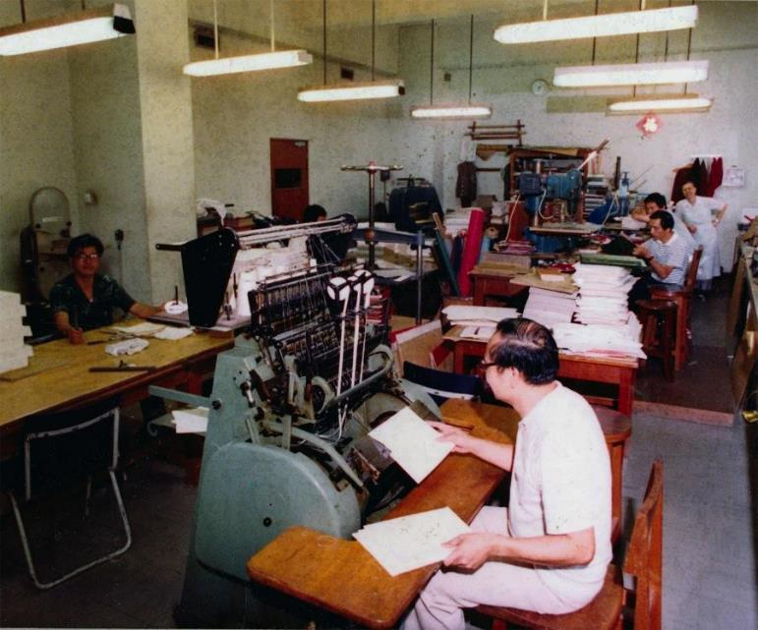
HKUL Bindery in Main Library – earlier days

Slide 14
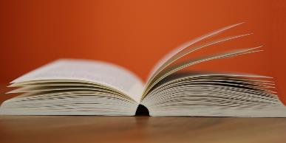


+
Mission Statement
  …HKUL shares with the University its aspiration to attain international distinction. To support the University's endeavours we work collaboratively across the institution to build, preserve and facilitate access to resources required to support the full academic programme…

Slide 15
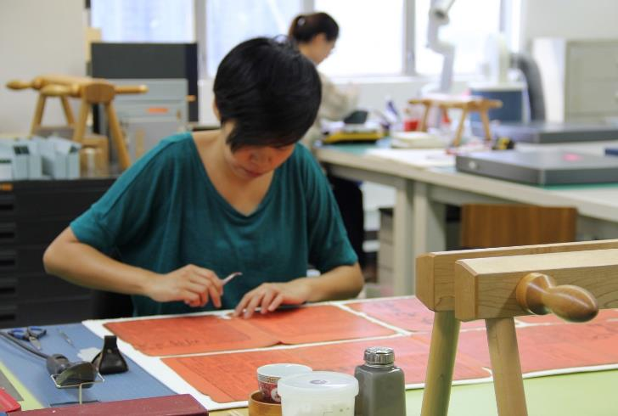
CORE ACTIVITIES of the Preservation & Conservation Division:
Preservation policies
Conservation treatment
Book repair
Environmental monitoring
Emergency prep & response
Pre-post digitization
Loans and exhibits
Staff and user education
Binding

Slide 16
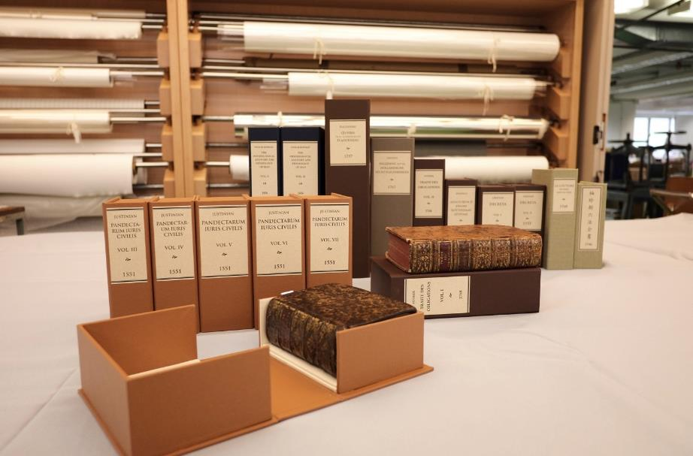
CHALLENGE: lack of local resources and awareness, turned into OPPORTUNITY for collaboration and outreach

Slide 17

Conservation & Preservation Committee
50+
CC&P Est. 2011

Slide 18
Since 2014 the HKUL Preservation Centre has organized:
  7 WORKSHOPS on preservation topics for all levels of participants
  4 WORKSHOPS or COURSES on highly specialized topics
  7 LECTURES
  3 EXHIBITIONS on preservation topics
  2 other ACTIVITIES
  Internship opportunities

Slide 19

COLLABORATING PARTNERS
University of Hong Kong Hong Kong Overseas
University Archives

Slide 20
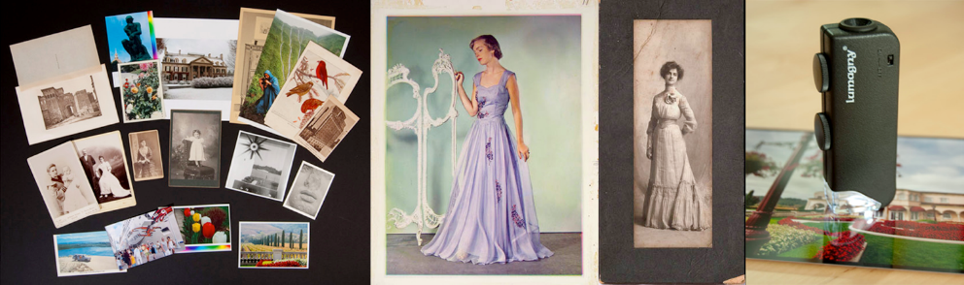
1
Care and Identification of Photographs
(from Daguerreotype to Digital)
Instructor: Gawain Weaver, Dates: April-May 2014 – 2 sessions, 4 days each
Participants developed identification skills and knowledge about fine art and historic photographic processes, from the daguerreotype to digital prints. Preservation topics included enclosures, handling guidelines, environmental monitoring, the effects of temperature and relative humidity on collections, and the importance of cold storage for certain photographic materials.
Collaborator: City University of Hong Kong, Cross-Disciplinary Institute, HK Maritime Museum, AXA Art

Slide 21
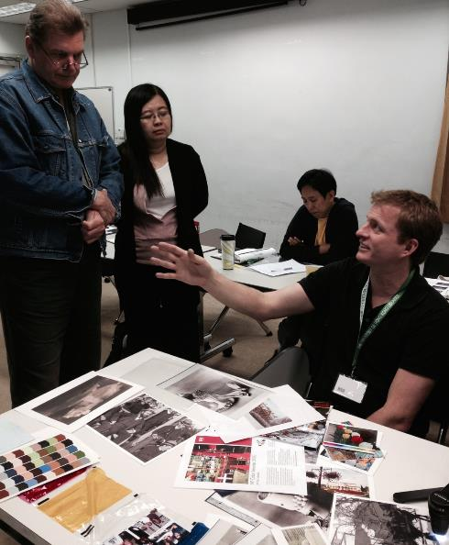
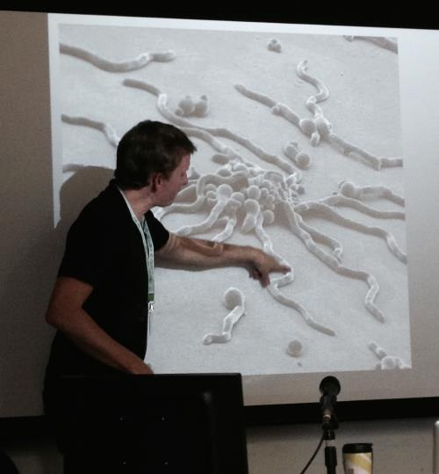
1
Care and Identification of Photographs
(from Daguerreotype to Digital)

Slide 22
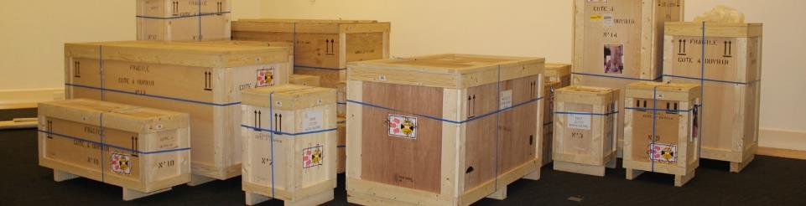
2
Best Practice for the Safe Handling, Soft Packing and Transport of Art and Artifacts
Instructor: Brent Powell , Dates: May-June 2015 – 2 sessions, 2 days each
This two-day Handling Workshop is designed to instruct attendees in the most current collections care practices, as well as the proper procedures and techniques for handling art and artifacts within museum and related environments. The primary target audience will include museum and gallery staff and art transport firm employees responsible for proper procedures and techniques for handling objects within their institutions and companies.
Collaborators: UMAG, M+ Funding: AXA Art, M+

Slide 23
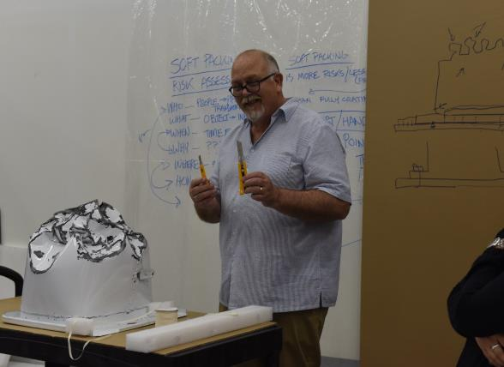
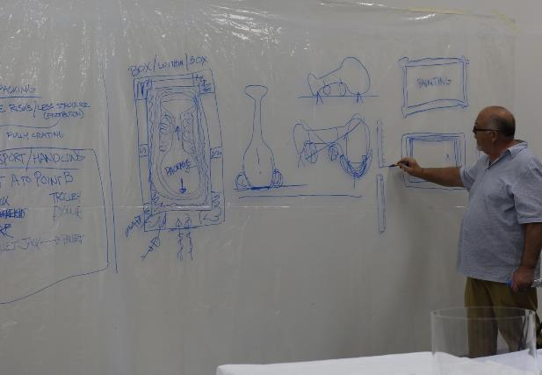
2
Best Practice for the Safe Handling, Soft Packing
and Transport of Art and Artifacts Instructor: Brent Powell

Slide 24

3
Information on the Arches Heritage Inventory and Management System
August 2015 – 2 days
The Getty Conservation Institute visited Hong Kong, Singapore and Taiwan in August to discuss the Arches heritage inventory and management system. Information included an overview of the Arches system and the new functionality available in version 3.0.
Topics covered included:
An overview of the management of heritage data in Arches, including international data standards, graphs, controlled vocabularies, and integration with external web services; System design and capabilities, including system architecture, creating and managing data, searching and reporting functionality, and geospatial layers; Arches deployment, including installation, data import and export, and configuration and potential customization.
Collaborators: UMAG, Getty Conservation Institute, World Monuments Fund

Slide 25
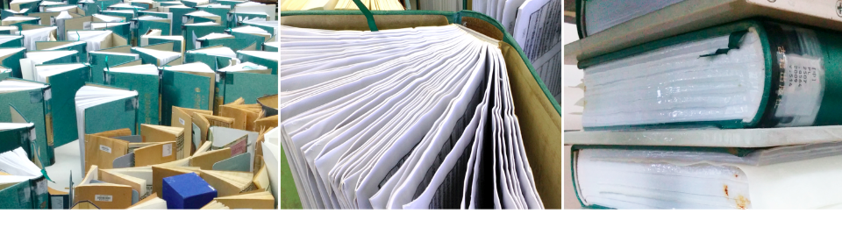
4
Collections Emergency Response & Recovery
Instructors: Priscilla Anderson & Jody Beenk, Dates: November 2014
The purpose of this workshop is to prepare staff to carry out response and recovery procedures during emergencies that threaten typical library and archival collections. The workshop consists of lectures, demonstration and hands-on practice in how to respond to an emergency effectively to prevent damage to the most vulnerable collections, and then how to salvage a variety of wet collection types during the recovery phase.
Collaborator: City University of Hong Kong, Cross-Disciplinary Institute Funding: AXA Art, M+

Slide 26
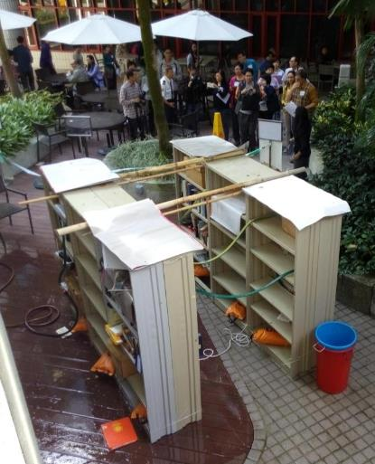
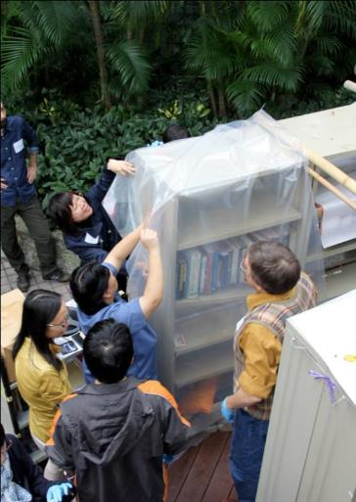
4
WORKSHOP Collections Emergency Response & Recovery
Staged water emergency
Participants cover shelves with plastic sheeting until water source is stopped

Slide 27
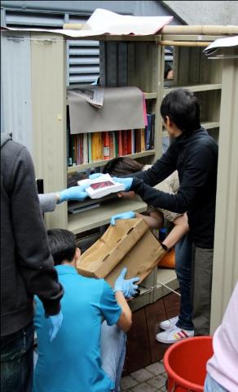
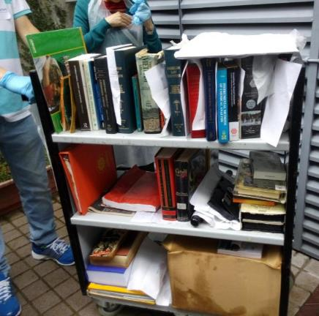
4
WORKSHOP Collections Emergency Response & Recovery
After assessing and reporting the situation, the team responds by removing wet items from shelving
Wet collections being transported to recovery area

Slide 28
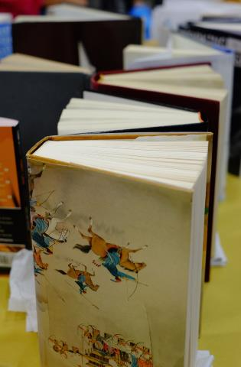
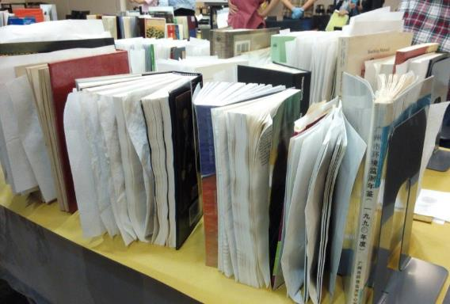
4
WORKSHOP Collections Emergency Response & Recovery
Air drying wet books

Slide 29
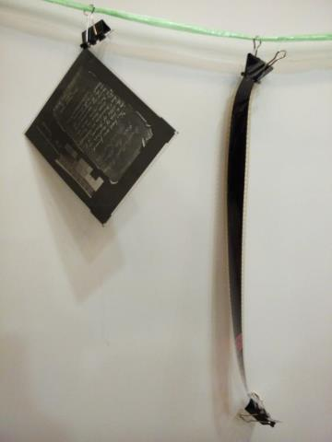
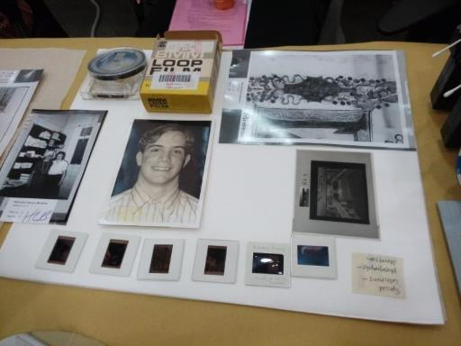
4
WORKSHOP Collections Emergency Response & Recovery
Left: film is clipped to a line to dry. The clip at the bottom prevents the film from curling
Above: photographs, slides, and film cassette laid out on blotter to air dry

Slide 30
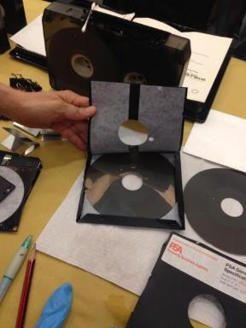
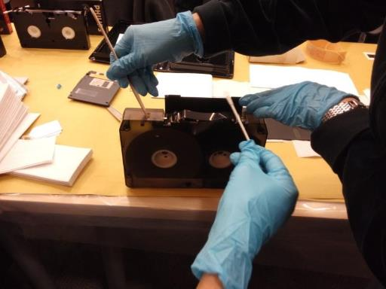
4
WORKSHOP Collections Emergency Response & Recovery
Magnetic media is checked for moisture content and opened to dry

Slide 31
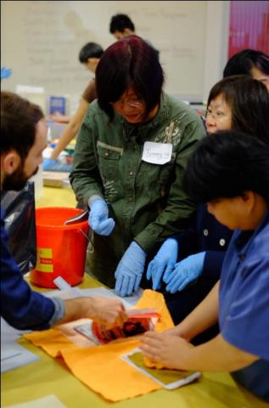
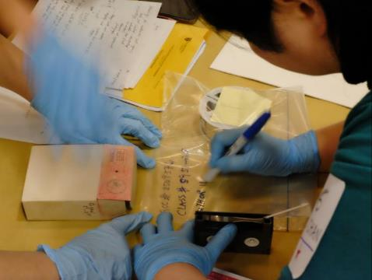
4
WORKSHOP Collections Emergency Response & Recovery
Documentation
Decision making

Slide 32
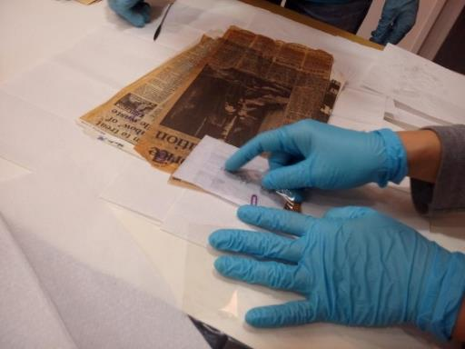
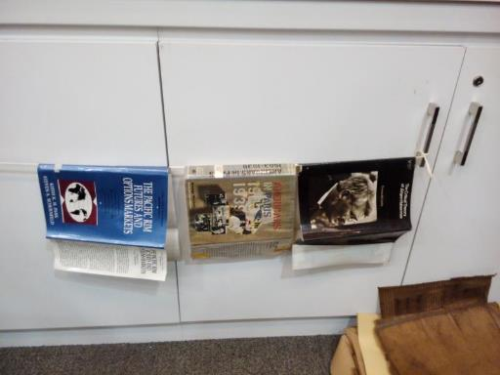
4
WORKSHOP Collections Emergency Response & Recovery
Dust jackets suspended on a line to dry
Removing paper clip with a Mylar sheet to prevent tearing of wet paper

Slide 33
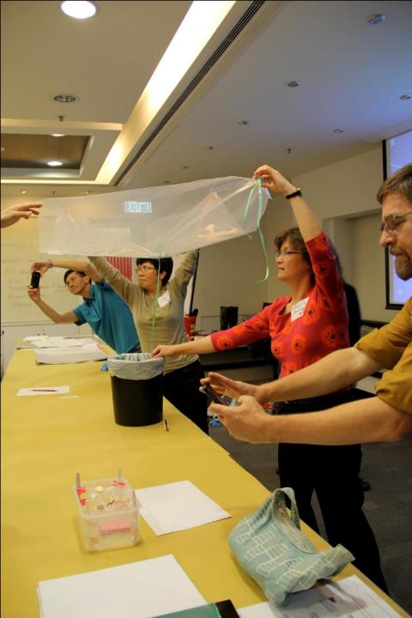

4
Collaborative Change: Better Together
JULAC Libraries Forum 24 April 2015
COLLABORATING ON EMERGENCY PREPAREDNESS

Slide 34
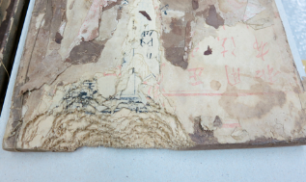
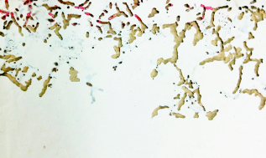
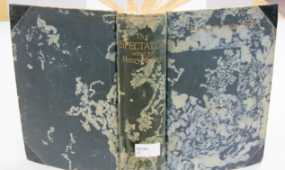
5
Integrated Pest Management (IPM)
Instructor: Dr Pascal Querner, Dates: December 2015 – 3 days, May 2016 – 3 days
The aim of the course is to show participants how IPM works, its most important aspects (monitoring, prevention, treatment, insect biology) and to give guidelines for how to apply IPM. After the course, all participants will be able to begin a monitoring program in their home institution, be able to identify the most important insect pests, and understand preventive measures such as cleaning, building sealing, temperature regulation and quarantine. Participants also will learn when to select between chemical free treatment methods such as heating, freezing, nitrogen, CO2, microwave and parasitic wasp reseal. Traditional treatment methods with biocides will be presented, along with the related advantages and disadvantages.
Collaborator: UMAG Funding: AXA Art

Slide 35
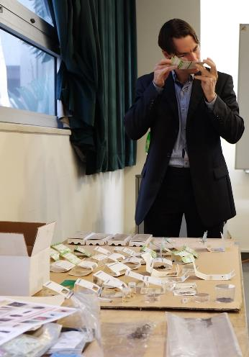
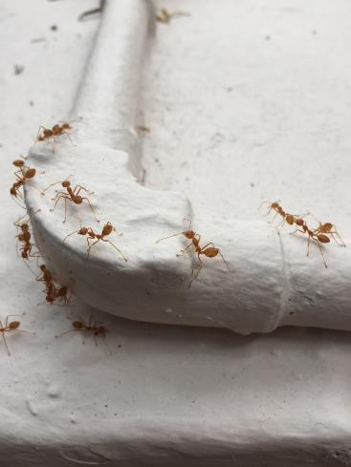
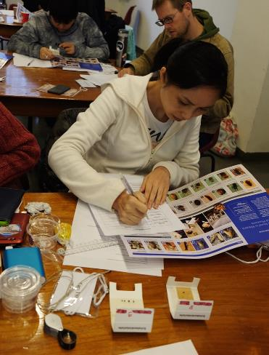
5
Integrated Pest Management (IPM)
Instructor: Dr Pascal Querner

Slide 36
6
Identification, Care & Handling of Architectural Drawings
Instructor: Lois Price
Dates: November 2016– 3 days
Lois Olcott Price is the former Director of Conservation and currently an Affiliated Assistant Professor at University of Delaware and Adjunct Senior Conservator at Winterthur Museum and Library
Participants learned about supports and media used for original architectural drawings; photo-reproductive processes used for architectural and engineering drawings;
typical deterioration problems associated with each type of material; housing options and materials and strategies for setting priorities and choosing the most appropriate housing.
+ PUBLIC LECTURE
Collaborator: UMAG

Slide 37
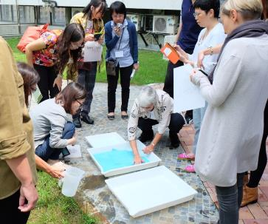
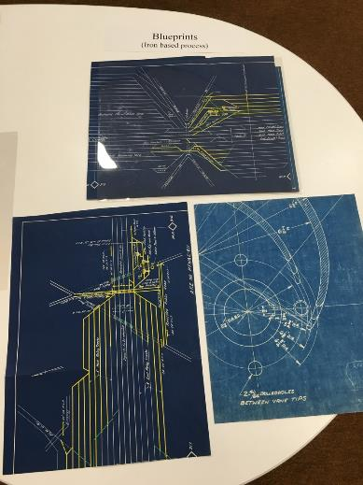
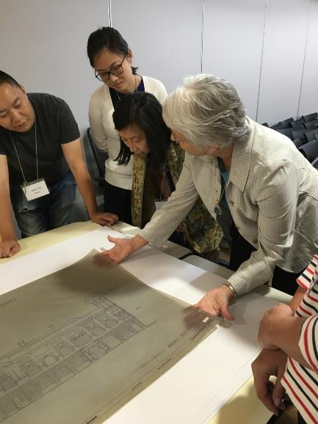
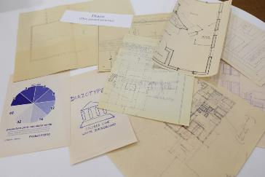
Identification, Care & Handling of Architectural Drawings
and photo-reproductive processes
6

Slide 38
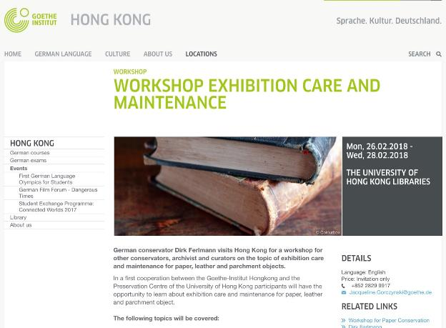
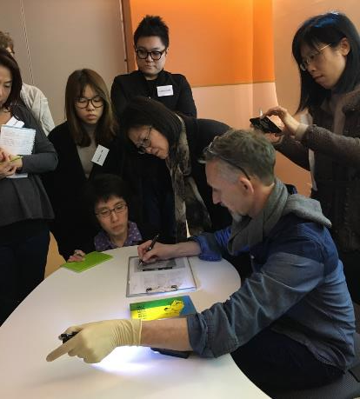
Exhibition Care and Maintenance
Instructor: Dirk Ferlmann, Conservator
Dates: February 2018 – 3-day workshop
7
Collaborator: Goethe Institute of Hong Kong, UMAG, Faculty of Arts

Slide 39
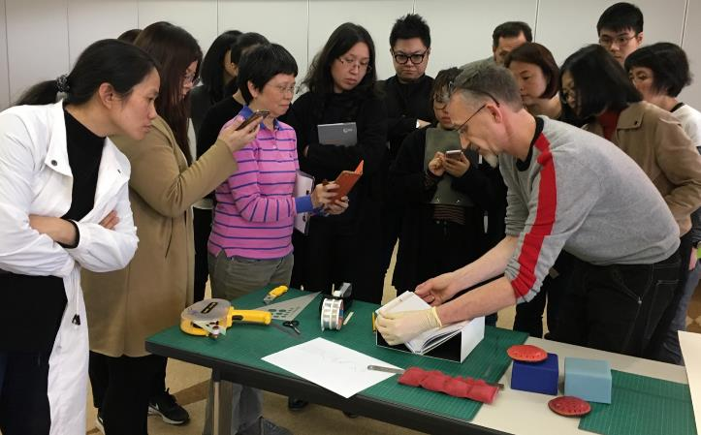
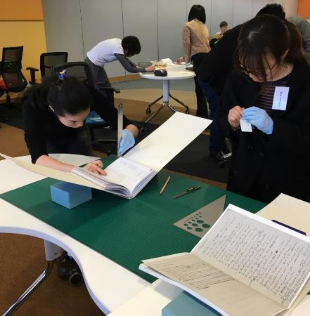
Exhibition Care and Maintenance
Instructor: Dirk Ferlmann, Conservator
Dates: February 2018 – 3-day workshop
7

Slide 40
4 Specialized Courses and 7 Lectures

Slide 41
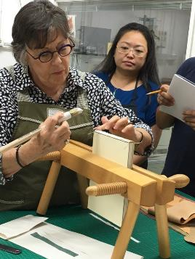


Leather Bookbinding
Instructor: Monique Lallier, Artist/Bookbinder
Dates: October 2017
1
This class familiarized students with the structure for fine bindings and many of the decorative techniques associated with design bindings, both historic and modern. Students focused on a number of decorative techniques with an emphasis on inlays and onlays to practice leather working techniques.
Collaborator: UMAG Funding: Mellon Foundation

Slide 42
Springback Binding
Instructor: Don Etherington
Dates: October 2017 – 2 days
2
Master craftsman Don Etherington demonstrated the techniques, tools and materials required for the construction of a traditional Springback Binding. A technique invented by the Englishmen John and Joseph Williams in about 1799, this form has been used ever since in the binding of ledgers and blank books.
Collaborator: UMAG
Funding: Mellon Foundation

Slide 43



Springback Ledger Binding (Demonstration)
Instructor: Don Etherington, conservator/bookbinder
2

Slide 44
Springback Ledger Binding (Demonstration)
Instructor: Don Etherington, conservator/bookbinder
2

Slide 45
1&2
Public Lectures & Exhibition
Monique Lallier
Forty + Years of Design Bindings
Don Etherington
The Influence of the Florence Flood on Conservation

Slide 46


Introduction to XRF Analysis
Instructor: Lee Drake, Dates: August 2017
3
Handheld XRF (X-ray fluorescence) spectrometers serve a wide range of applications in the fields of art, conservation and archaeology. XRF allows for the non-destructive and in-situ elemental analysis.
PUBLIC LECTURE:
Application of Handheld XRF in Cultural Heritage Conservation
Collaborators: UMAG & HKU Architectural Conservation Program, M+ Funding: Mellon Foundation

Slide 47

The History of the Book in China
Instructor: Soren Edgren
Dates: December 2017, 1 week intensive course
4
This course offered a comprehensive history of books in China with reference to relevant developments in Korea and Japan and to parallels in the West. It treated the subject in the broadest sense, from the advent of actual books in East Asia during the first millennium BCE to the introduction of virtual books at the end of the twentieth century; however, emphasis was placed on the traditional Chinese book printed on paper from the ninth to the nineteenth century.
PUBLIC LECTURE:
Buddhist Illuminated manuscripts in China and East Asia
Collaborator: UMAG, Funding: Mellon Foundation

Slide 48
PUBLIC LECTURE
Isabel Meyer – Manager for the Smithsonian Digital Asset Management System (museums, libraries, archives and even the zoo)
Management and preservation of digital collections in cultural institutions
Collaborators: M+ Museum, UMAG & HKU Faculty of Arts Funding: M+ and Mellon Foundation

Slide 49


18th Century Armenian Prayer Scrolls
Speaker: Collette Badmagharian, Getty/UCLA post-grad
PUBLIC LECTURE & SHARING SESSION
Collaborators: Hong Kong Library Association, HKU Museum Society, UMAG
Funding: Mellon Foundation

Slide 50


14 workshops (more than one day in length)
10 libraries, 8 archives, 1 insurance company, 8 heritage organizations, 9 museums, 4 art galleries, 5 art handling companies, 14 private individuals, 10 students & interns, 2 university facilities management departments
276 participants
Hong Kong | Macau | Philippines | Myanmar | Malaysia | Nepal | Taiwan | China | Singapore

Slide 51
What’s next for Preservation at HKUL?
Continue with local and regional collaborations on short workshops
Development of undergraduate level courses in preservation
to increase awareness of career paths in preservation/conservation
Internships
Capacity building

Slide 52
ACTIVITY
DIY NOTEBOOK MAKING

